Slide 1

Christine Micheel, Ph.D.
10th International Biocuration Meeting
March 2017

Slide 2

Mission of My Cancer Genome
To curate and disseminate knowledge regarding the clinical significance of genomic alterations in cancer

Slide 3

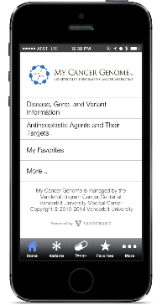
Dissemination
Clinically Integrated Solutions
Publicly Available Resources
Vanderbilt EHR info button
Website
My Cancer Genome
>7240 patients
Laboratory Reporting Tool
>3.7M page views, 211 countries
>9000 specimens,
18 institutions
Mobile App
Molecular Consult Tool

Slide 4
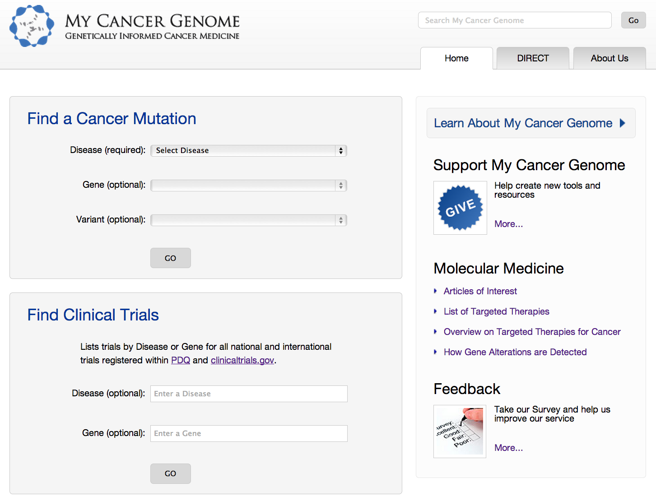
Manually Curated Content
23 Cancers
ALL
ALCL
AML
CLL
CML
MDS
GIST
IMT
Breast
Gastric
Glioma
Lung
Colorectal
Basal Cell Carcinoma
Bladder
Medulloblastoma
Melanoma
Neuroblastoma
Ovarian
Prostate
Rhabdomyosarcoma
Thymic
Thyroid
20 Pathways
825 Genes
23 Cancers
456 Variants
625 Drugs

Slide 5
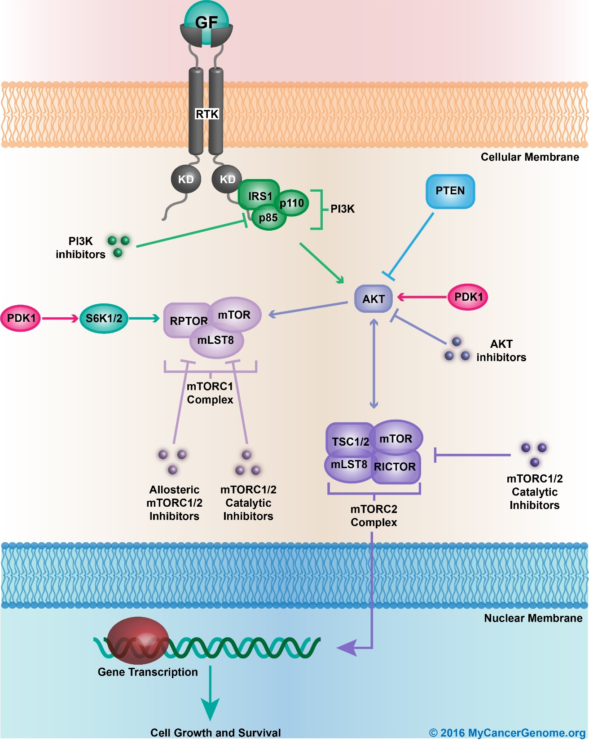
Map Kinase Pathway
20 Cancer Pathways
Associated Genes, Drugs, Diagnoses

Slide 6
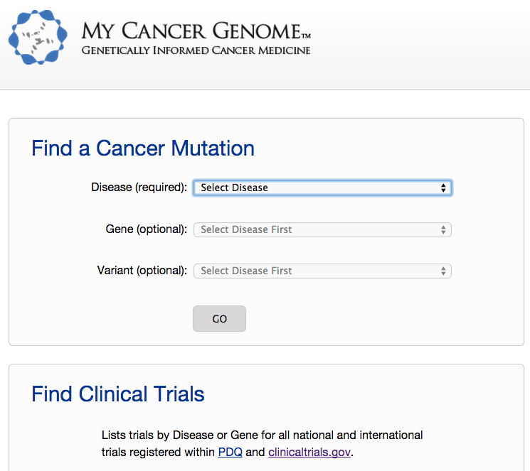

Slide 7
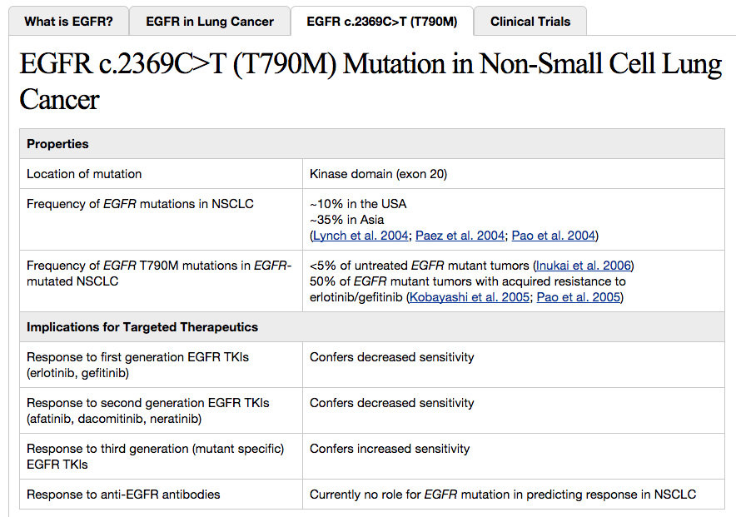
Location of Alteration in Gene
Types of Evidence
FDA Approvals
Guidelines
Published clinical trial results
Retrospective cohort analysis
Case Reports
Clinical trial eligibility criteria
Pre-clinical studies
Frequency of Alteration in Disease
Response to Drug
Sensitivity/Resistance

Slide 8
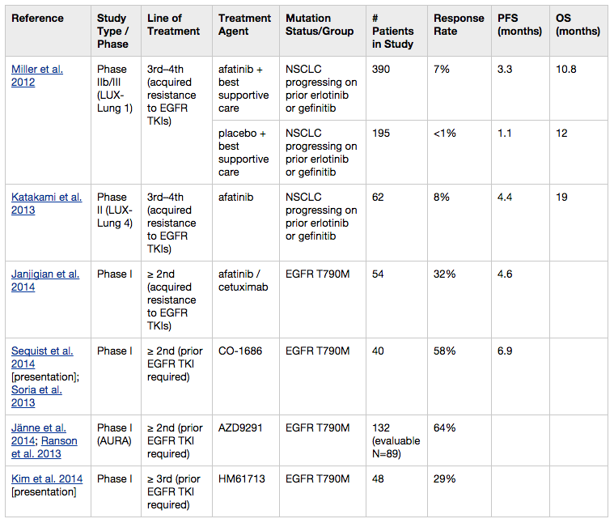

Slide 9
Transition to Structured Knowledgebase:
Current MCG Structured Content
Therapeutic and prognostic assertions
  226 therapeutic assertions
  163 prognostic assertions (primarily hematologic malignancies)
Clinical trials
  30,138 trials imported from clinicaltrials.gov
  ~2,000 trials curated with biomarker eligibility criteria

Slide 10
What is a therapeutic assertion?
EVIDENCE SUPPORTS USING FOLLOWING DRUG FOR PATIENT’S TUMOR TYPE, BASED ON GENOMIC ANALYSIS
Drug | Disease | Alteration | Treatment Setting | Level of Evidence | References
Cabozantinib | NSCLC | RET Fusion | Adjuvant/Metastatic | MODERATE | NCCN Guidelines (4. 2017)
Diagnosis
Alteration
Drug
Level of Evidence
Reference

Slide 11
Therapy Assertion
Lung Cancer & Erlotinib
(single alteration)
EGFR L858R mutation
Response:
Primary Sensitivity
Line of Therapy:
Metastatic

Slide 12
Therapy Assertions
Lung Cancer & Erlotinib
(co-occuring alterations)
EGFR L858R mutation
EGFR T790M mutation
AND
Response:
Acquired Resistance
Line of Therapy:
Metastatic

Slide 13
Therapy Assertion
Colon Cancer & Cetuximab
(Alteration NOT detected in Variant Group)
KRAS Exon 2, 3, or 4 mutation
NRAS Exon 2, 3, or 4 mutation
AND
NOT DETECTED
NOT DETECTED
Response:
Primary Sensitivity
Line of Therapy:
Metastatic
Source:
FDA (KRAS Exon 2)
Source:
NCCN (KRAS Exon 2, 3, 4)
Source:
ASCO (KRAS Exon 2)

Slide 14
Clinical Trial Annotation
Clinical Trial A
Eligibility Criteria Group 1
Disease Group(s)
Biomarker Group(s)
Eligibility Criteria Group 2
Eligibility Criteria Group 3
Include
Include
Exclude
Exclude
Eligibility Criteria Group n

Slide 15
Example: NCI Match
NCI Match
Disease Group(s)
Biomarker Group(s)
Eligibility Criteria Group G
Include:
Solid Tumor
Lymphoma
Include:
BRAF V600E/K/R/D Mutation
Eligibility Criteria Group H
Eligibility Criteria Group U
Exclude:
Melanoma
Colorectal &
Papillary Thyroid Cancer
Exclude:
Resistance mutations
Eligibility Criteria Group B
Eligibility Criteria Group R
Eligibility Criteria Group n

Slide 16
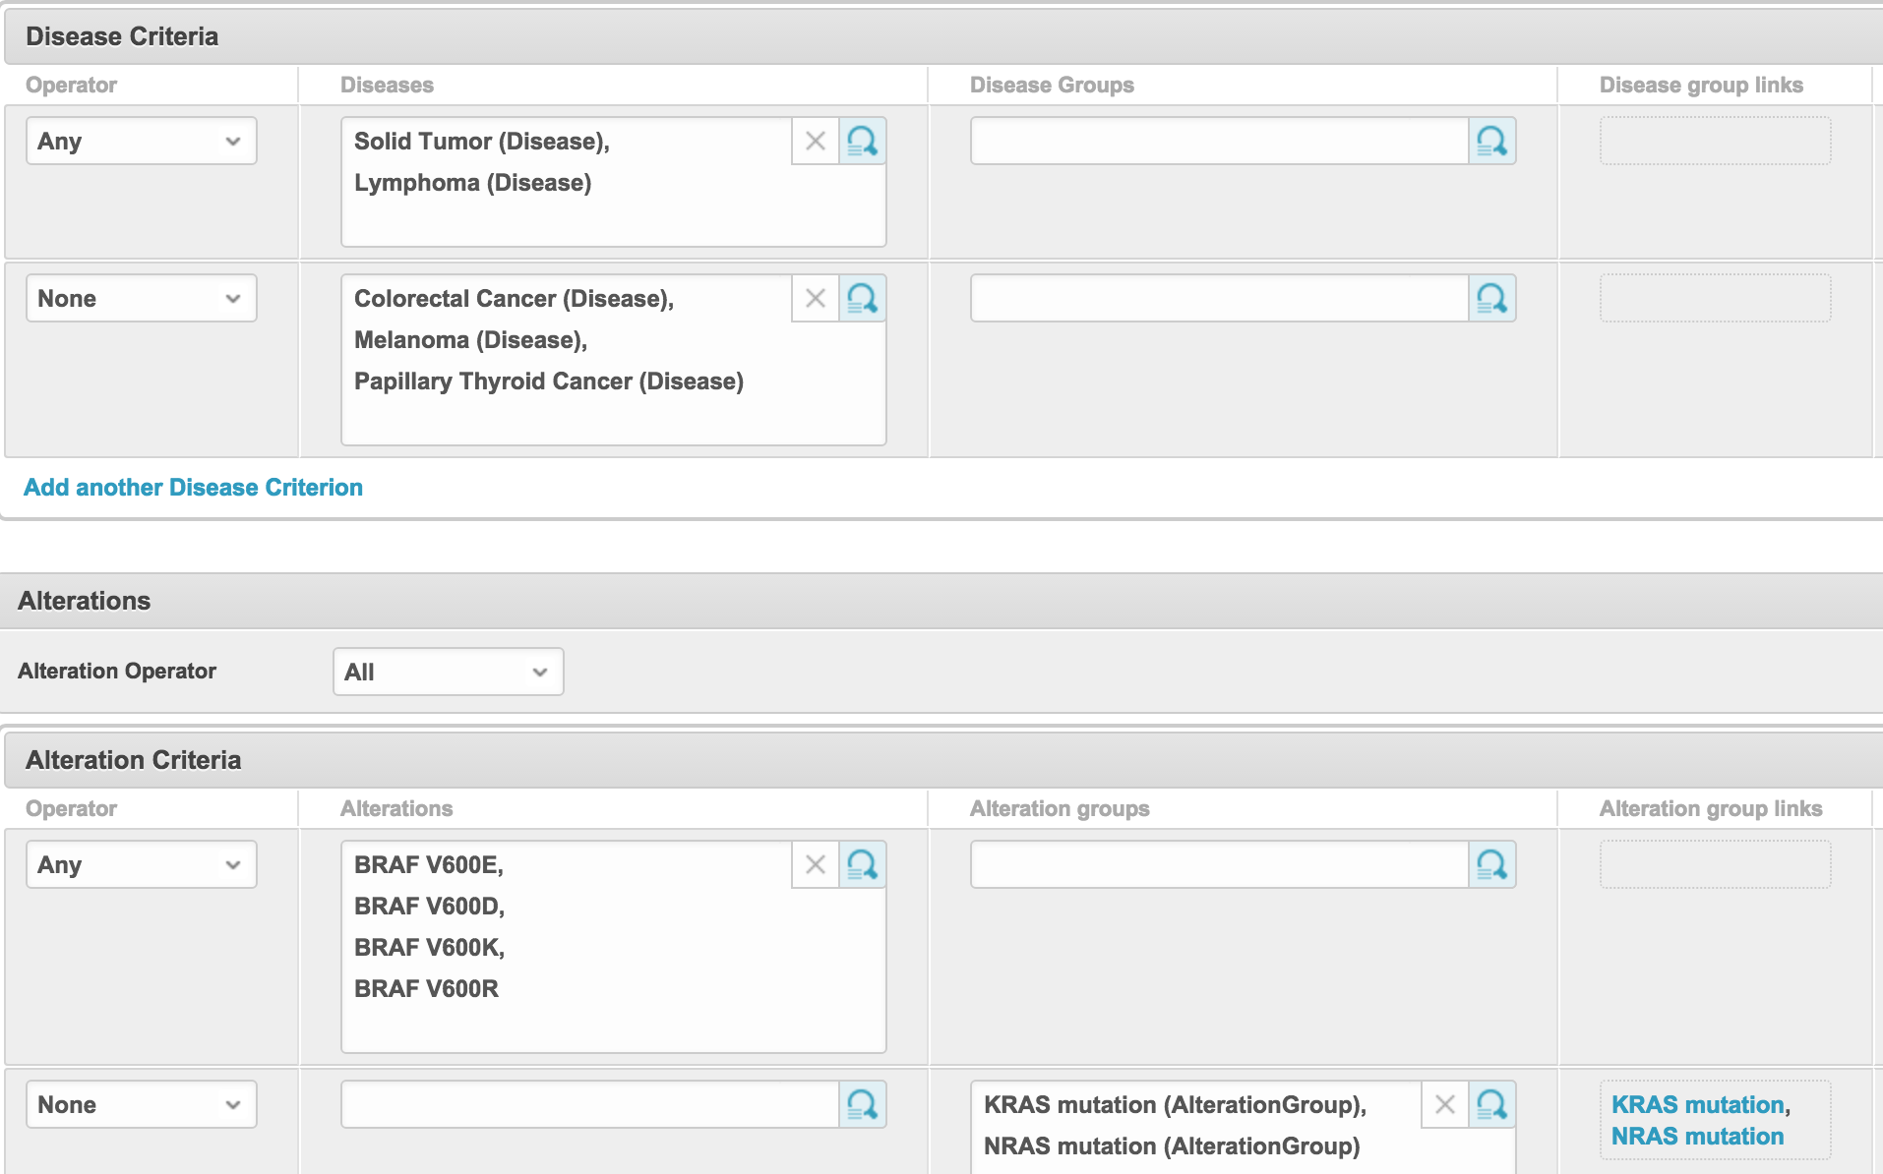
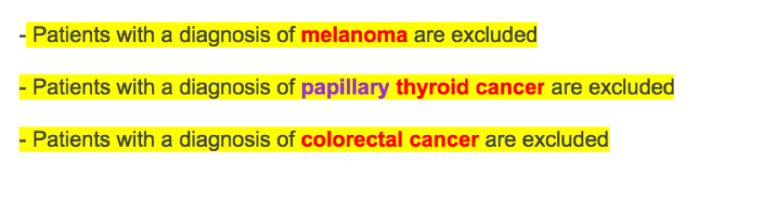
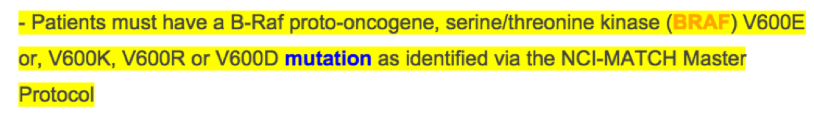
Curation: Disease & Biomarker Criteria
Linking Text in Primary Document to Annotation
Notes:
Here is a screenshot from our knowledge management system for curating clinical trial eligibility criteria. This is where we curate disease eligibility, and this is where we curate alteration criteria. As you can see, we can have multiple logical operators per ”arm”, and we can also create groups of diseases and alterations to add further complexity to the criteria.
We record the sources of our curations by importing and highlighting both the clinicaltrials.gov and the NCI clinical trial documents. This is arm H of NCI-MATCH, although this is an older version of the actual groups we use. Here you can see highlights for the disease exclusions and highlights for the alteration inclusions.
In the future, we will add eligibility criteria based on prior therapies, and eventually extend to include all common eligibility criteria.

Slide 17
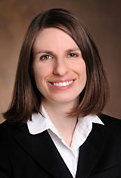
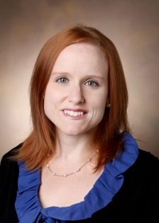
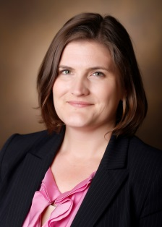
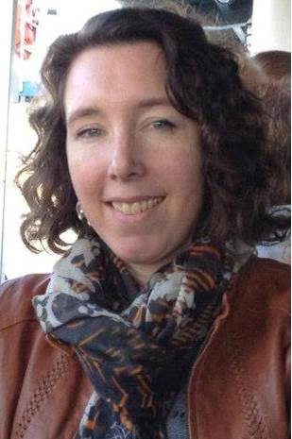
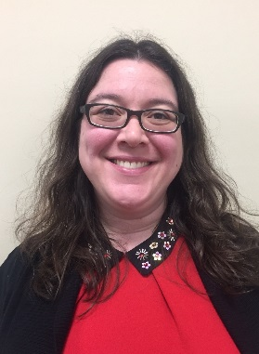
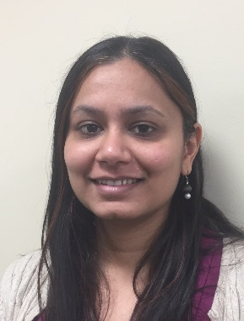
Acknowledgements
Mia Levy
Christine Lovly
Christine Micheel
Ingrid Anderson
Michele LeNoue-Newton
Neha Jain
Scott Sobecki
Joey Schneider
Mik Cantrell
Ross Oreto
Melissa Stamm
Lucy Wang
Danny Wenner
Mikhail Zemmel
Nunzia Giuse
Taneya Koonce
Sheila Kusnoor
Patricia Lee
Helen Naylor
Alan Bentley
Michael Villalobos
GenomOncology
MCG Contributors
MCG Alumni
And many more…

Slide 18
Thank You christine.micheel@vanderbilt.edu

